Slide 1





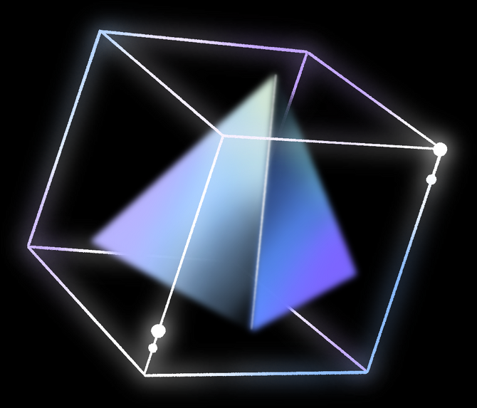
APPLICATION DATAVIZ
DESK APP
By Yann SkØ

Slide 2
TABLE OF CONTENTS
Context
Project Objectives
Methodology
Features of ap
Demo / Improvement points
Conclusion
01
02
03
04
05
06

Slide 3

CONTEXT
Création d’une application desktop
Cahier des charges:
Exclusivement en Python
Base de données relationnelle
Gestion Json
Application desktop de Visualisation

Slide 4



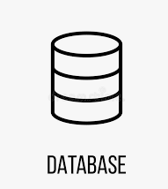



PROJECT OBJECTIVES
TRAITEMENTS
GESTION
VALORISATION

Slide 5


METHODOLOGIE

Slide 6




TECH USED

Slide 7
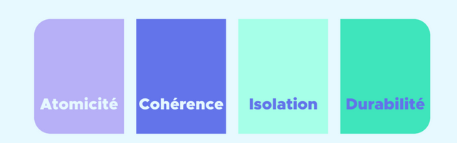

WHY POSTGRE

Slide 8

TIME LINE
01
02
03
04
Get_the_Data From Api’s
Treat_data and MakE
CRUD with Db
Clean _data to plot
Realize DeskApp

Slide 9

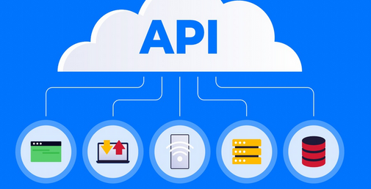

DATA SOURCES

Slide 10

LES DIFFÉRENTES FEATURES
- VISUALISATION DE FICHIERS/ DONNÉES
- MANAGEMENT DE DB
- VISION DES LOGS TEMPS REELS
- SETTINGS ET GESTION DE BACKUP

Slide 11


Slide 12
LA DÉMO

Slide 13



LES AXES DAMÉLIORATIONS
GESTION DES PROJETS DEVS
TEST UNITAIRES
OPTIMISATION PERFORMANCES

Slide 14
CONCLUSION

Slide 15
RESOURCE PAGE
CUSTOM TKINTER:
HTTPS://GITHUB.COM/TOMSCHIMANSKY/CUSTOMTKINTER/TREE/MASTER
POSTGRESQL15:
HTTPS://WWW.POSTGRESQL.ORG/DOCS/RELEASE/15.0/
MON REPO:
HTTPS://GITHUB.COM/YANNSKO/DESK_APP
API_MAIN:
HTTPS://WWW.ALPHAVANTAGE.CO/DOCUMENTATION/
DATASET:
HTTPS://WWW.ZILLOW.COM/RESEARCH/DATA/

